Slide 1
City of Bonita Springs, Florida
Evaluation and Appraisal Review
Public Meeting
June 7, 2022
5:30-7:00

Slide 2
Team Introduction
Dr. Margaret Banyan
FGCU Professor
Stantec Team
Carmen Monroy, MPA
Erica McCaughey
FGCU Graduate Student

Slide 3
EAR Workshop Agenda
5:30 - 5:35 Registration, Welcome & Introductions
5:35 – 6:10 EAR Overview
6:10 – 6:40 Community Discussion
6:40 –7:00 Report Out, Wrap Up, and Next Steps

Slide 4
About the Comprehensive Plan
Supports the City’s vision of the future
Long range policies, programs & public investments
Guides the physical development of the City
Expresses intent through Goals, Objectives & Policies

Slide 5
Comprehensive Plan Elements
Future Land Use
Transportation
Housing
Infrastructure
Conservation/Coastal Management
Recreation & Open Space
Intergovernmental Coordination
Capital Improvements
Public Participation
Public School Facilities

Slide 6
Relationship to Other Planning Tools
Comprehensive Plan
Land Development Code
Strategic Plan
Broad / long term intent
Specific development regulations
Priorities
Funding

Slide 7
The Evaluation and Appraisal Review (EAR)
Review required every seven years by the State of Florida
Known officially as: Evaluation and Appraisal Review of the Comprehensive Plan ^{i}
Review changes in Comprehensive Plan needed to reflect changes in state requirements
Review changes needed to meet City and community goals
Review changes needed to reflect changes in trends and local conditions
Develop preliminary suggestions for amendments to the Comprehensive Plan
EAR does not re-write the Comprehensive Plan
i. See: https://www.floridajobs.org/community-planning-and-development/programs/community-planning-table-of-contents/evaluation-and-appraisal-of-comprehensive-plans

Slide 8
EAR Process Overview
1
2
3
Evaluation
and Appraisal
Report 2023
Amend
Comprehensive
Plan 2024
Land
Development
Regulations Future
Review CURRENT Bonita Springs Plan
Update planning goals, objectives, and policies as needed
Revise land development regulations

Slide 9
Bonita Springs EAR Process
HERE
Preliminary Research
Project Framework
Report
EAR Draft Report Winter 2023
LPA & Council Review
Winter 2023
Submission to State DEO
By 4/1/23
Background Report
Fall 2022
Project Framework
Report
ONGOING PUBLIC OUTREACH & CIVIC ENGAGEMENT

Slide 10
City of Bonita Springs Strategic Priority Areas
Quality of Life
Water & Environment
Governance
Economic Development

Slide 11
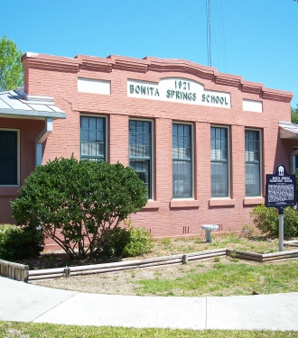
Quality of Life
Strong Neighborhoods & Healthy Communities
Walkability & Complete Streets
Transportation
Land Use
Housing
Parks & Recreation
Emergency Evacuation
Schools

Slide 12
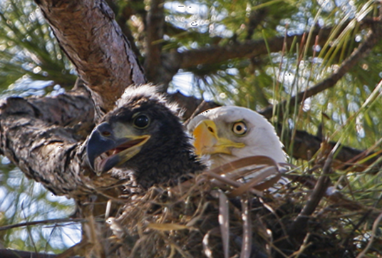
Water & Environment
Growth & Development
Water Quality
Stormwater
Utilities
Beach & River Water

Slide 13
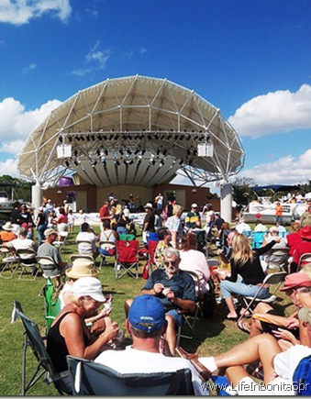
Economic Development
Downtown
City-wide aesthetics
Development Priorities
Density
Land Use
Industry and Commerce
Employment
Corridor Development

Slide 14
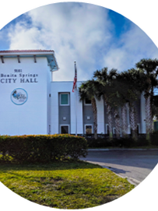
Governance
Intergovernmental Relationships & Cooperation
Citizen Outreach & Accessibility
Financial Resilience

Slide 15
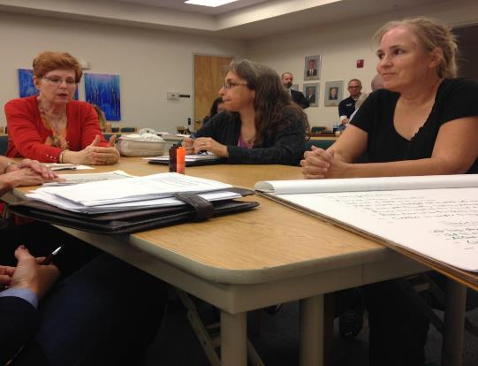
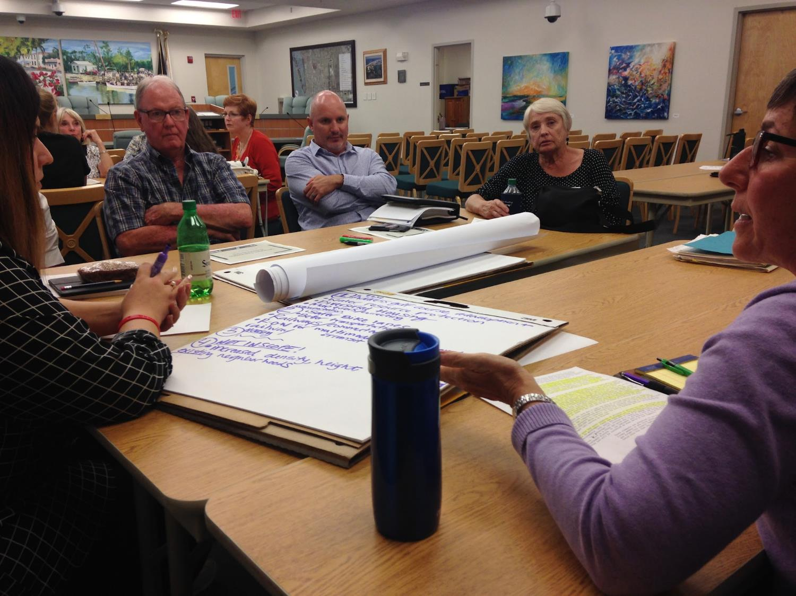
Discussion Groups
Ground Rules
Respect all viewpoints
Be patient and cooperative
Listen to one another
Be brief and to the point
Small Table Discussions
15 minutes per table
Ideas on easel pads
Keeping record of ideas
Then… Switch to new topic
Online email to: bonitaear2023@cityofbonitasprings.org

Slide 16
Discussion Questions
Quality of Life
What actions or policies will protect or enhance quality of life in the City?
Water & Environment
What actions or policy should the City consider in the area of water and environment?
Economic Development
What actions or policies support economic development?
Governance
What actions or policies support good governance?
How do you define quality of life?
What water / environment issues are important to you?
What does good governance mean to you?
What should the city consider in economic development ?

Slide 17
Future EAR Engagement
Meeting Focus | Timeframe
Public Meeting: Framework Report | Fall 2022
Community Survey | Fall 2022
Public Meeting: EAR Review Findings | January / February 2023
Local Planning Agency and City Council Meetings | Fall 2022 February / March 2023

Slide 18
Information and Resources
City of Bonita Springs
https://www.cityofbonitasprings.org/
EAR Contact Email
bonitaear2023@cityofbonitasprings.org
Project Contact
Dr. Margaret Banyan | 239.590.7850 | mbanyan@fgcu.edu
Department of Economic Opportunity
https://floridajobs.org/community-planning-and-development/programs/community-planning-table-of-contents/evaluation-and-appraisal-of-comprehensive-plans

